Slide 1



Performance Analysis of FPGA Acceleration on Intel DevCLoud
Najmeh Nazari
Research Assistant, UC Davis
May 2021
Dr. Houman Homayoun, Associate Professor, University of California, Davis
Larry Landis, Senior Manager University Outreach, Intel Programmable Solutions Group

Slide 2
Outline
Heterogeneous Computing Lab (10 min)
HosNa Benchmark (5 min)
Performance Analysis (25 min)
Hands on Experience (30 min)

Slide 3
Outline
Heterogeneous Computing Lab
HosNa Benchmark
Performance Analysis
Hands on Experience

Slide 4
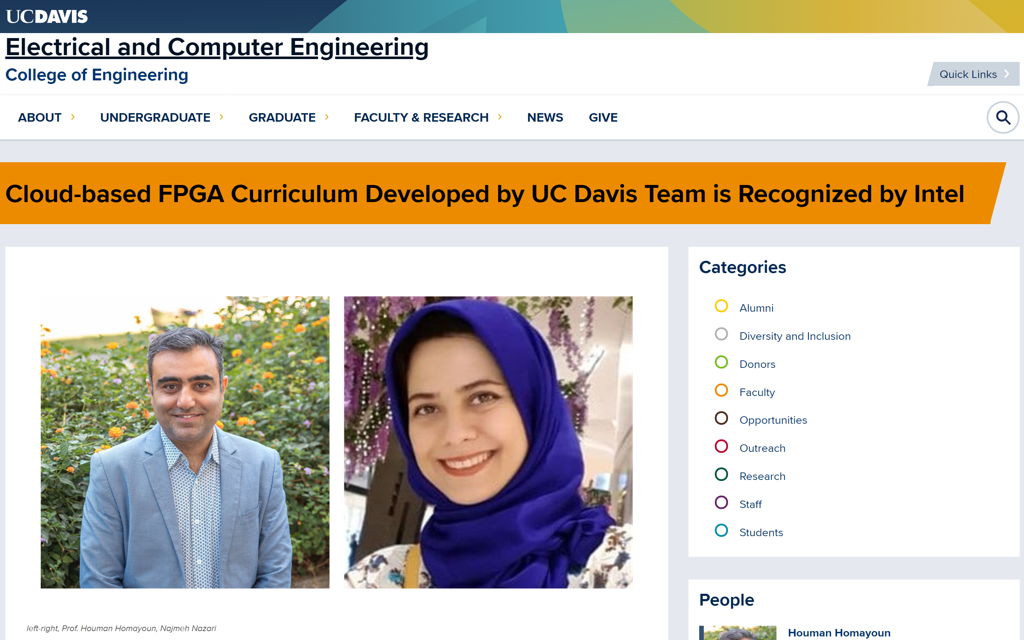
Introduction
https://ece.ucdavis.edu/news/cloud-based-fpga-curriculum-developed-uc-davis-team-recognised-intel

Slide 5
What We Cover in Heterogeneous Computing Lab?
Introduction to DevCloud
Implementing AES in Software
Migrating to DPC++
Performance Analysis
Implementing AES with RTL
Design Space Exploration and DPC++ Optimization

Slide 6
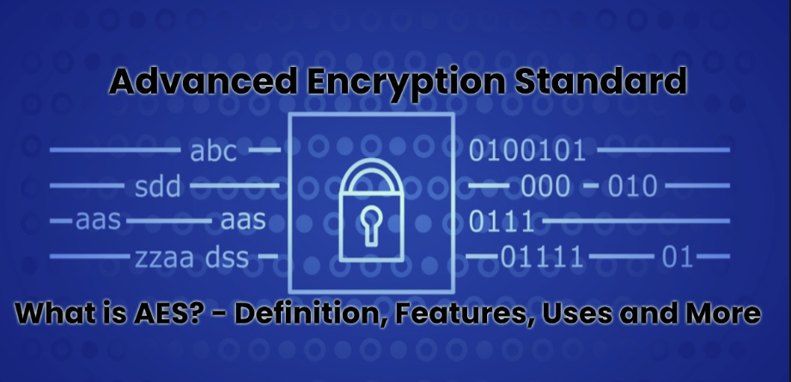
Why AES?
AES is a popular cipher: a method or process used to change raw information (usually human readable) into something that cannot be read. (Encryption)
uses a known, external piece of information (key), to uniquely change the data.
Reversible: it can be applied again to put the information back into its original form (Decryption)

Slide 7
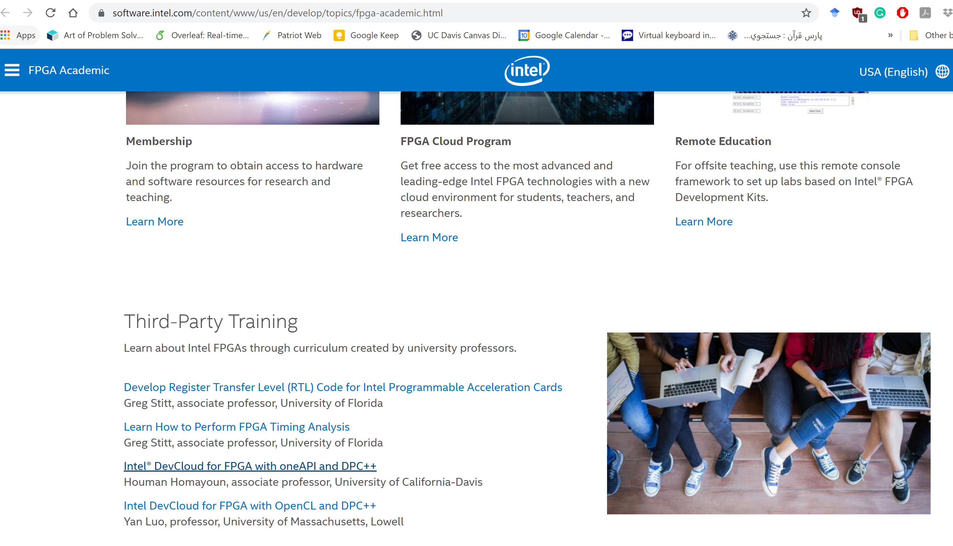
Intel Training Module
https://software.intel.com/content/www/us/en/develop/topics/fpga-academic.html

Slide 8
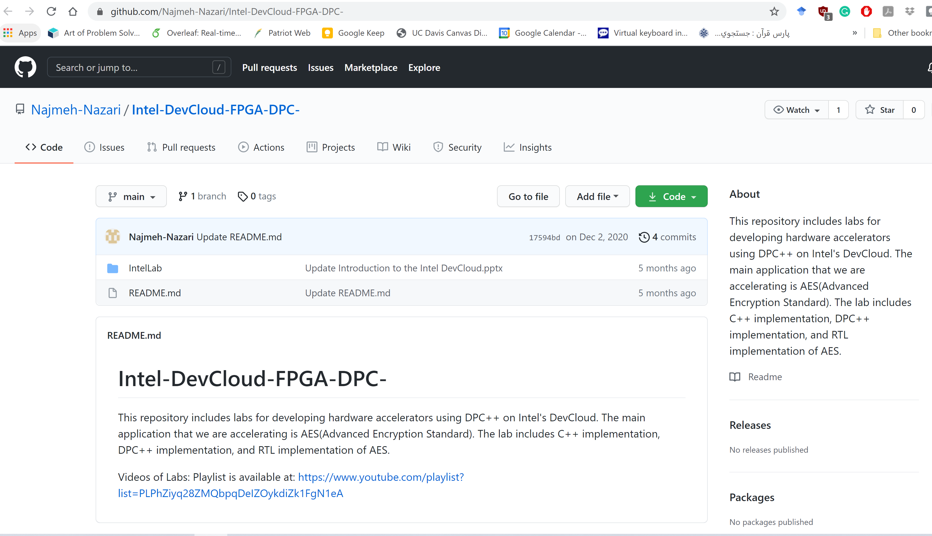
GitHub Repository
https://github.com/Najmeh-Nazari/Intel-DevCloud-FPGA-DPC-

Slide 9
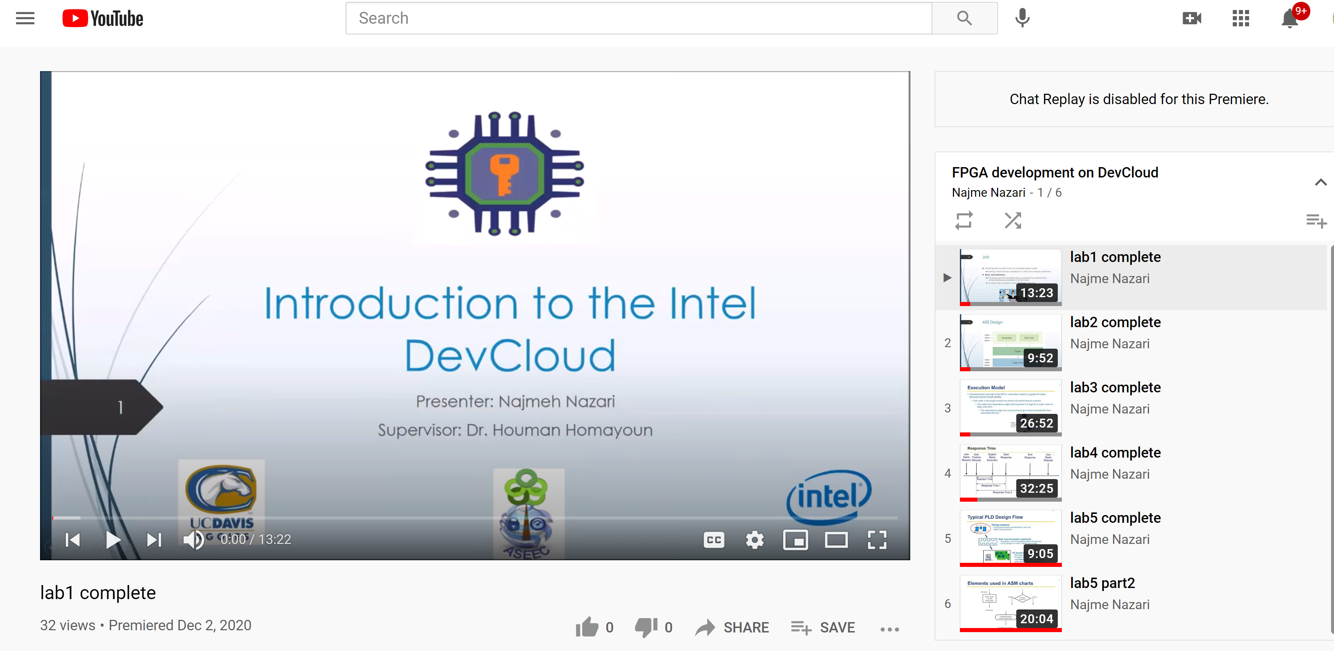
YouTube Videos
https://www.youtube.com/watch?v=6Agr_7gz6Yk&list=PLPhZiyq28ZMQbpqDeIZOykdiZk1FgN1eA&index=1

Slide 10
Outline
Heterogeneous Computing Lab
HosNa Benchmark
Performance Analysis
Hands on Experience

Slide 11
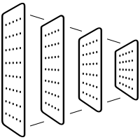

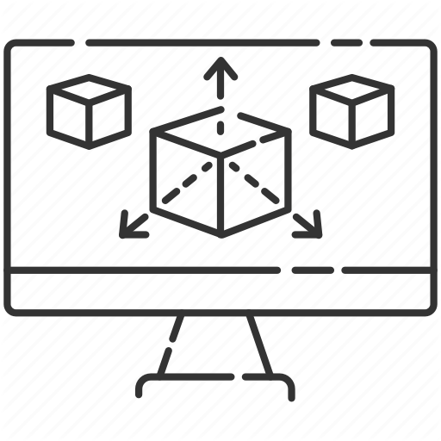



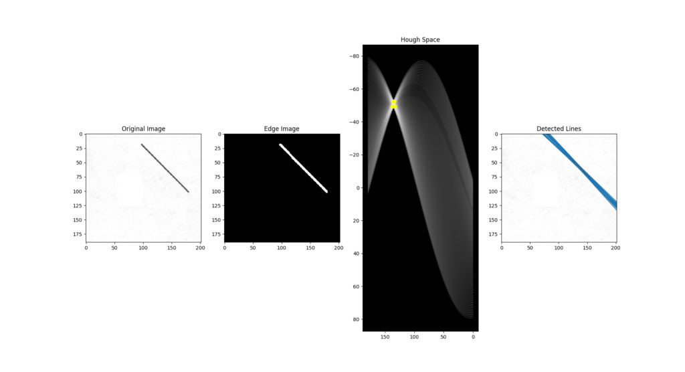
What is HosNa?
2D Convolution
Digit Recognition
3D Rendering
AES
Hough Transform
MIPS
Spam Filtering

Slide 12
DPC++ Optimizations
Avoiding pointer aliasing and pointer arithmetic
Converting nested loops to a single loops where it was possible
Global memory access optimization by preloading data into local memory
Having a continuous memory access and specifying the number of memory banks and bank width whenever possible
Avoiding to define a float variable as much as possible, tree balancing for floating point optimization, and removing floating-point rounding operation
Using pragmas and attributes for loops and memory such as loop unrolling and max concurrency in the source code

Slide 13
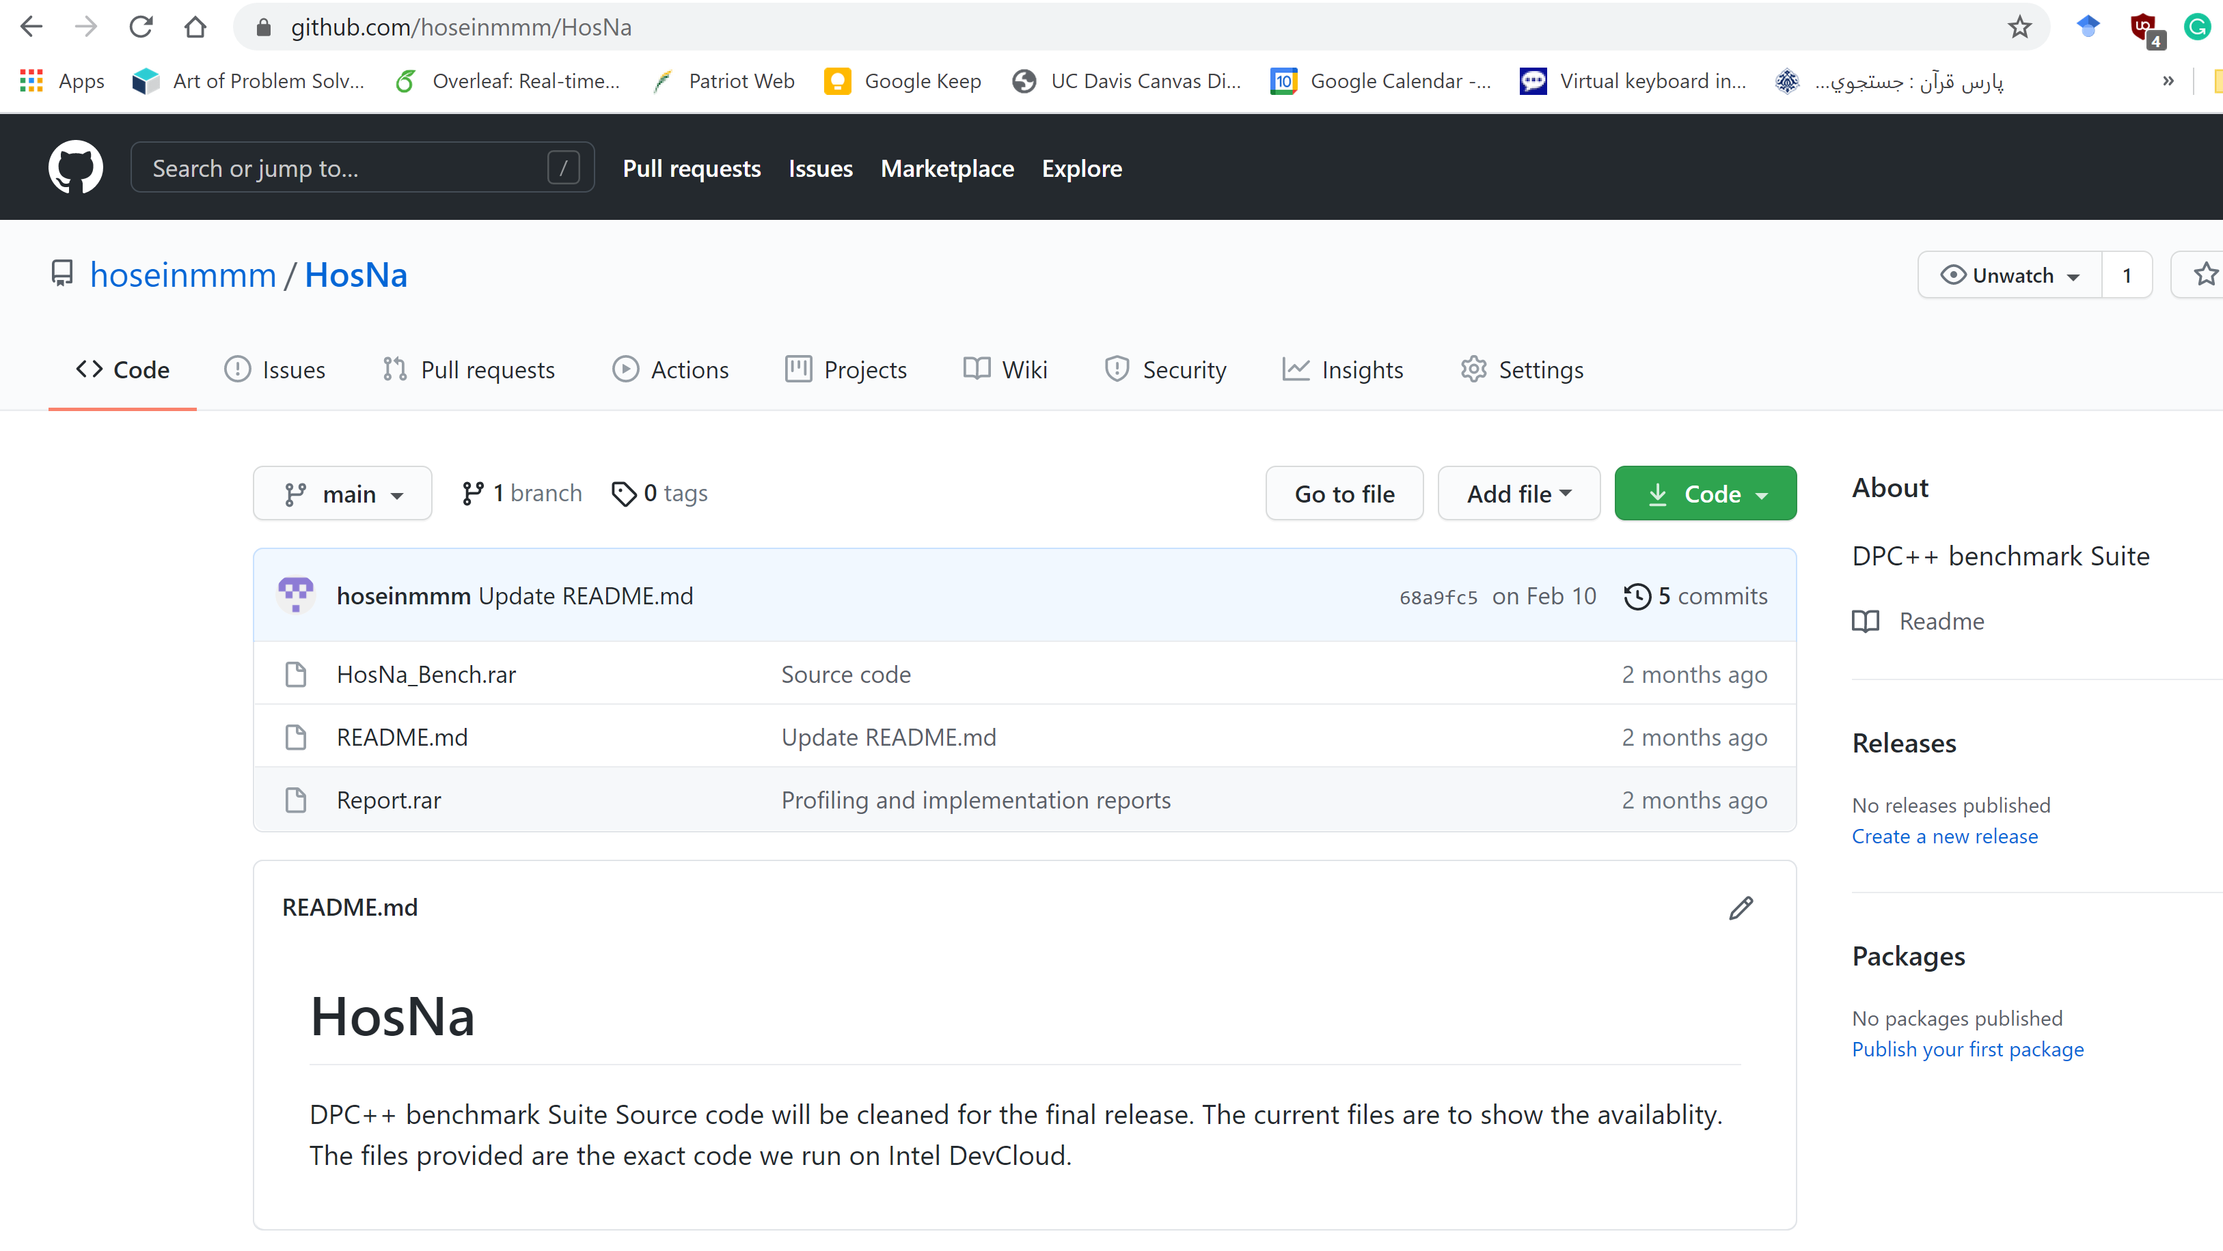
How to Access HosNa
https://github.com/hoseinmmm/HosNa

Slide 14
What You Can Find in HosNa
Software version
DPC++ version – Naïve code
DPC++ version – Optimized code
Job scripts
Input files
Golden output file
Performance analysis reports (VTune, Advisor)

Slide 15
Outline
Heterogeneous Computing Lab
HosNa Benchmark
Performance Analysis
Concepts
Intel Vtune for FPGA profiling
Intel Advisor for Hotspots detection
Hands on Experience

Slide 16
Systems Performance Analysis

Slide 17
What is involved in PA?

Slide 18
Commonly Used Performance Metrics

Slide 19
Response Time

Slide 20


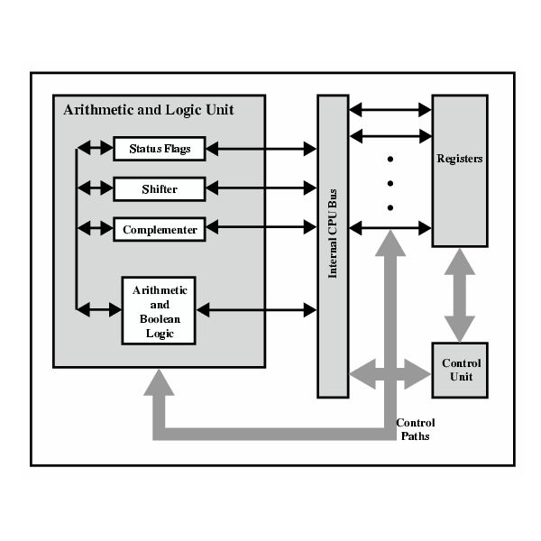

Modern Computers System
System
Socket
Core
Memory
IO HUB
CORE
CORE
CORE
Core
Memory
IO HUB
Memory
L3 Cache
IO HUB
Uncore
IMC
Intel IO
Clock
Intel QPI
Memory
IO HUB

Slide 21
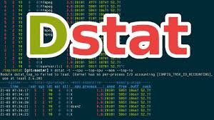



Popular Tools
Intel VTune
Intel Advisor
MICA
Perf
PCM
System-level information
Low-level Microarchitecture- Independent information
Low-level Microarchitecture- Dependent information
Low-level Uncore information

Slide 22
Intel Advisor
A prototyping tool that allows users to analyze their code and determine the costs and benefits of adding various threading models on Intel processors.
Works on code written in C, C++, and Fortran.
Can model parallelism using OpenMP
Provide guidance to help codes get better vectorization
A graphical user interface (GUI)
Accessed with the advixe-gui
Begin by creating a new project, entering the executable path and arguments, and setting other options. Once the Advisor project is created, run through the threading and/or vectorization workflows
A command line (CL) interface
Accessed with the advixe-cl commands.
Command line can be available on DevCloud.

Slide 23
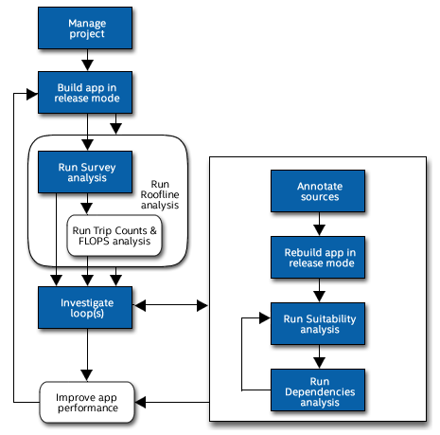
Advisor Workflow (I)
1. Survey Report
Shows the loops where your application spends the most time
Use this information to discover candidates for parallelization with threads.
2. Trip Counts analysis
Shows the number of times a loop body will execute and is invoked
Use this information to make better decisions about your threading strategy for particular loops.
3. Roofline chart
visualize actual performance
Determine the main limiting factor
Providing an ideal roadmap of potential optimization steps

Slide 24
Advisor Workflow (II)
Annotations
Insert to mark places in your application
Subroutines that can be processed by your current compiler but do not change the computations of your application.
Suitability Report
Predicts the maximum speed-up of your application
Use this information to choose the best candidates for parallelization with threads
Dependencies Report
Predicts parallel data sharing problems
Use this information to fix the data sharing problems if the predicted maximum speed-up benefit justifies the effort.

Slide 25
Intel Advisor
Survey
Trip Counts
FLOPS
Roofline Analyses

Slide 26

Survey Analysis
Where will vectorization pay off the most?
If vectorized loops are providing benefit?
Un-vectorized loops
Performance problems

Slide 27
Trip Counts Analysis
Dynamically identifies the number of times loops and functions are invoked and executed
Use Trip Counts data to:
Detect loops with too-small trip counts
Analyze parallelism granularity.

Slide 28
FLOPS Analysis
Dynamically measures
Floating-point operations
Integer operations
Memory traffic.
Using the FLOP analysis
Generate application memory usage and performance values
Help you make better decisions about your vectorization strategy.

Slide 29

Roofline Analysis
Helps you visualize actual performance against hardware-imposed performance ceilings
Determine the main limiting factor (memory bandwidth or compute capacity)
Providing an ideal roadmap of potential optimization steps.
Use the Roofline chart to answer the following questions:
What is the maximum achievable performance with your current hardware resources?
Does your application work optimally on current hardware resources?
If not, what are the best candidates for optimization?
Is memory bandwidth or compute capacity limiting performance for each optimization candidate?

Slide 30
Refinement Reports
Intel Advisor offers two refinement analyses:
Dependencies analysis (optional)
For safety purposes, the compiler is often conservative when assuming data dependencies.
Run a Dependencies analysis to check for real data dependencies in loops the compiler did not vectorize because of assumed dependencies.
If real dependencies are detected, the analysis can provide additional details to help resolve the dependencies.
Your objective: Identify and better characterize real data dependencies that could make forced vectorization unsafe.
Memory Access Patterns (MAP) analysis (optional)
Run a MAP analysis to check for various memory issues, such as non-contiguous memory accesses and unit stride vs. non-unit stride accesses.
Your objective: Eliminate issues that could lead to significant vector code execution slowdown or block automatic vectorization by the compiler.

Slide 31
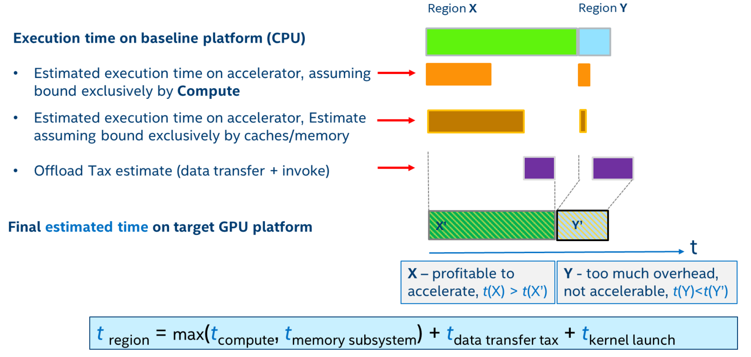
Offload Advisor
Intel Advisor (Beta)
Includes Offload Advisor, a tool that allows you to collect performance predictor data in addition to the profiling capabilities of Intel Advisor.
Design Code for Efficient Vectorization, Threading, and Offloading to Accelerators

Slide 32
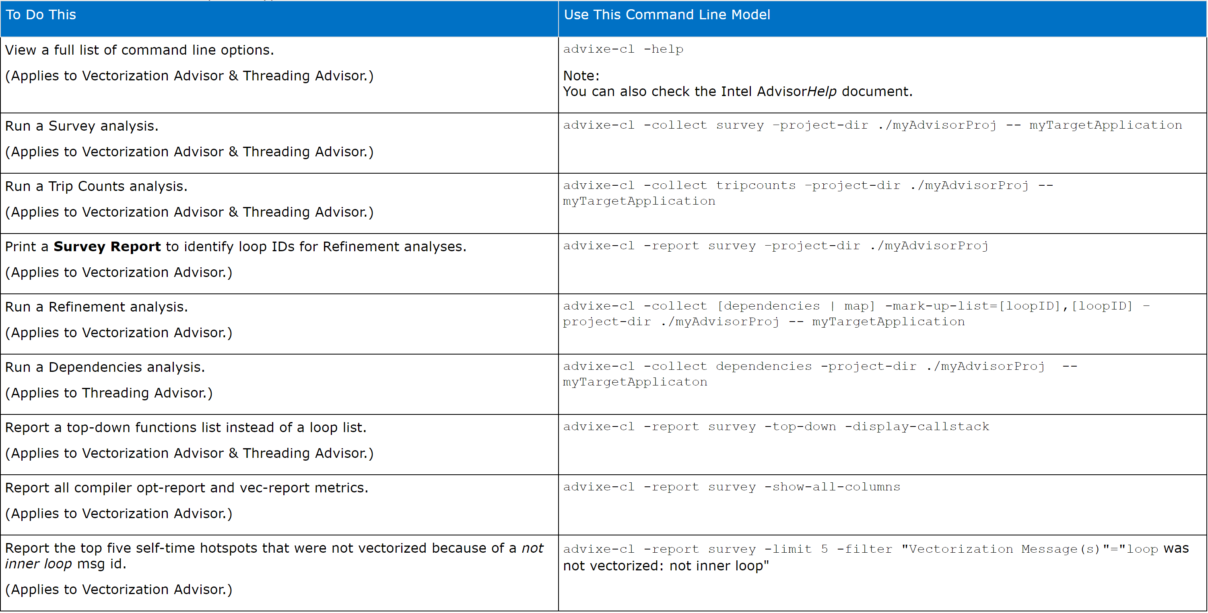
How to use Advisor?
Use command line interface : advixe-cl to run analyses and reports.
Notes:
These are some commands that can be used.

Slide 33
Intel VTune
A performance profiling tool for C, C++, and Fortran code
Identify where in the code time is being spent in both serial and threaded applications.
For threaded applications, it can also determine the amount of concurrency and identify bottlenecks created by synchronization primitives.
VTune Profiler uses dynamic instrumentation and thus does not require use of Intel compilers or the use of any special compiler flags.
A graphical user interface (GUI)
Accessed with the vtune-gui
A command line (CL) interface
Accessed with the vtune.
The analysis types include:
Hotspots
Threading
Memory Consumption.

Slide 34
Analysis Types
Hotspot
Profile your code's execution to determine which functions are consuming the most time and thus are targets for optimization.
The threading analysis
Analyzes how well a threaded application takes advantage of multi-core.
FPGA-Interaction
Analyze the CPU/FPGA interaction issues via exploring OpenCL kernels running on FPGA, identify the most time-consuming FPGA kernels
The memory consumption analysis
Identifies RAM usage over time and identifies memory objects allocated and released during the analysis run.

Slide 35
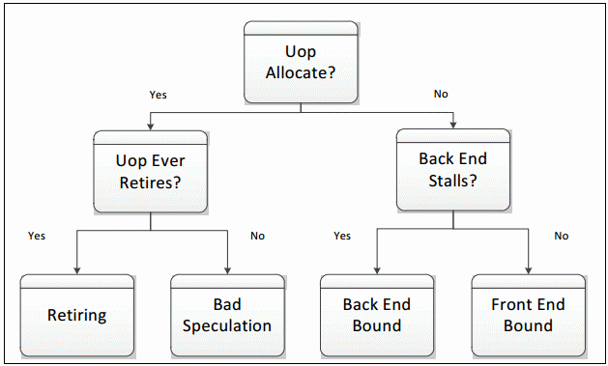
Microarchitectural Tuning Methodology

Slide 36
When do you use Intel Vtune VS Advisor?
Intel Vtune
What’s your cache hit ratio?
Which loop/function is consuming most time overall?(bottom-up)
Are you stalling often? IPC?
Are you keeping all the threads busy?
Are you hitting remote NUMA?
When do you maximize your BW?
Intel Advisor
Which ISA are you using?
Flow of execution (callstacks)
What is your vectorization efficiency?
Can you safely force vectorization?
Inlining? Data type conversion?
Roofline

Slide 37
Outline
Heterogeneous Computing Lab
HosNa Benchmark
Performance Analysis
Hands on Experience
Emulation Flow
Performance Analysis (Run Vtune and Advisor)
Run bitstream on FPGA and Compare DPC++ VS C

Slide 38
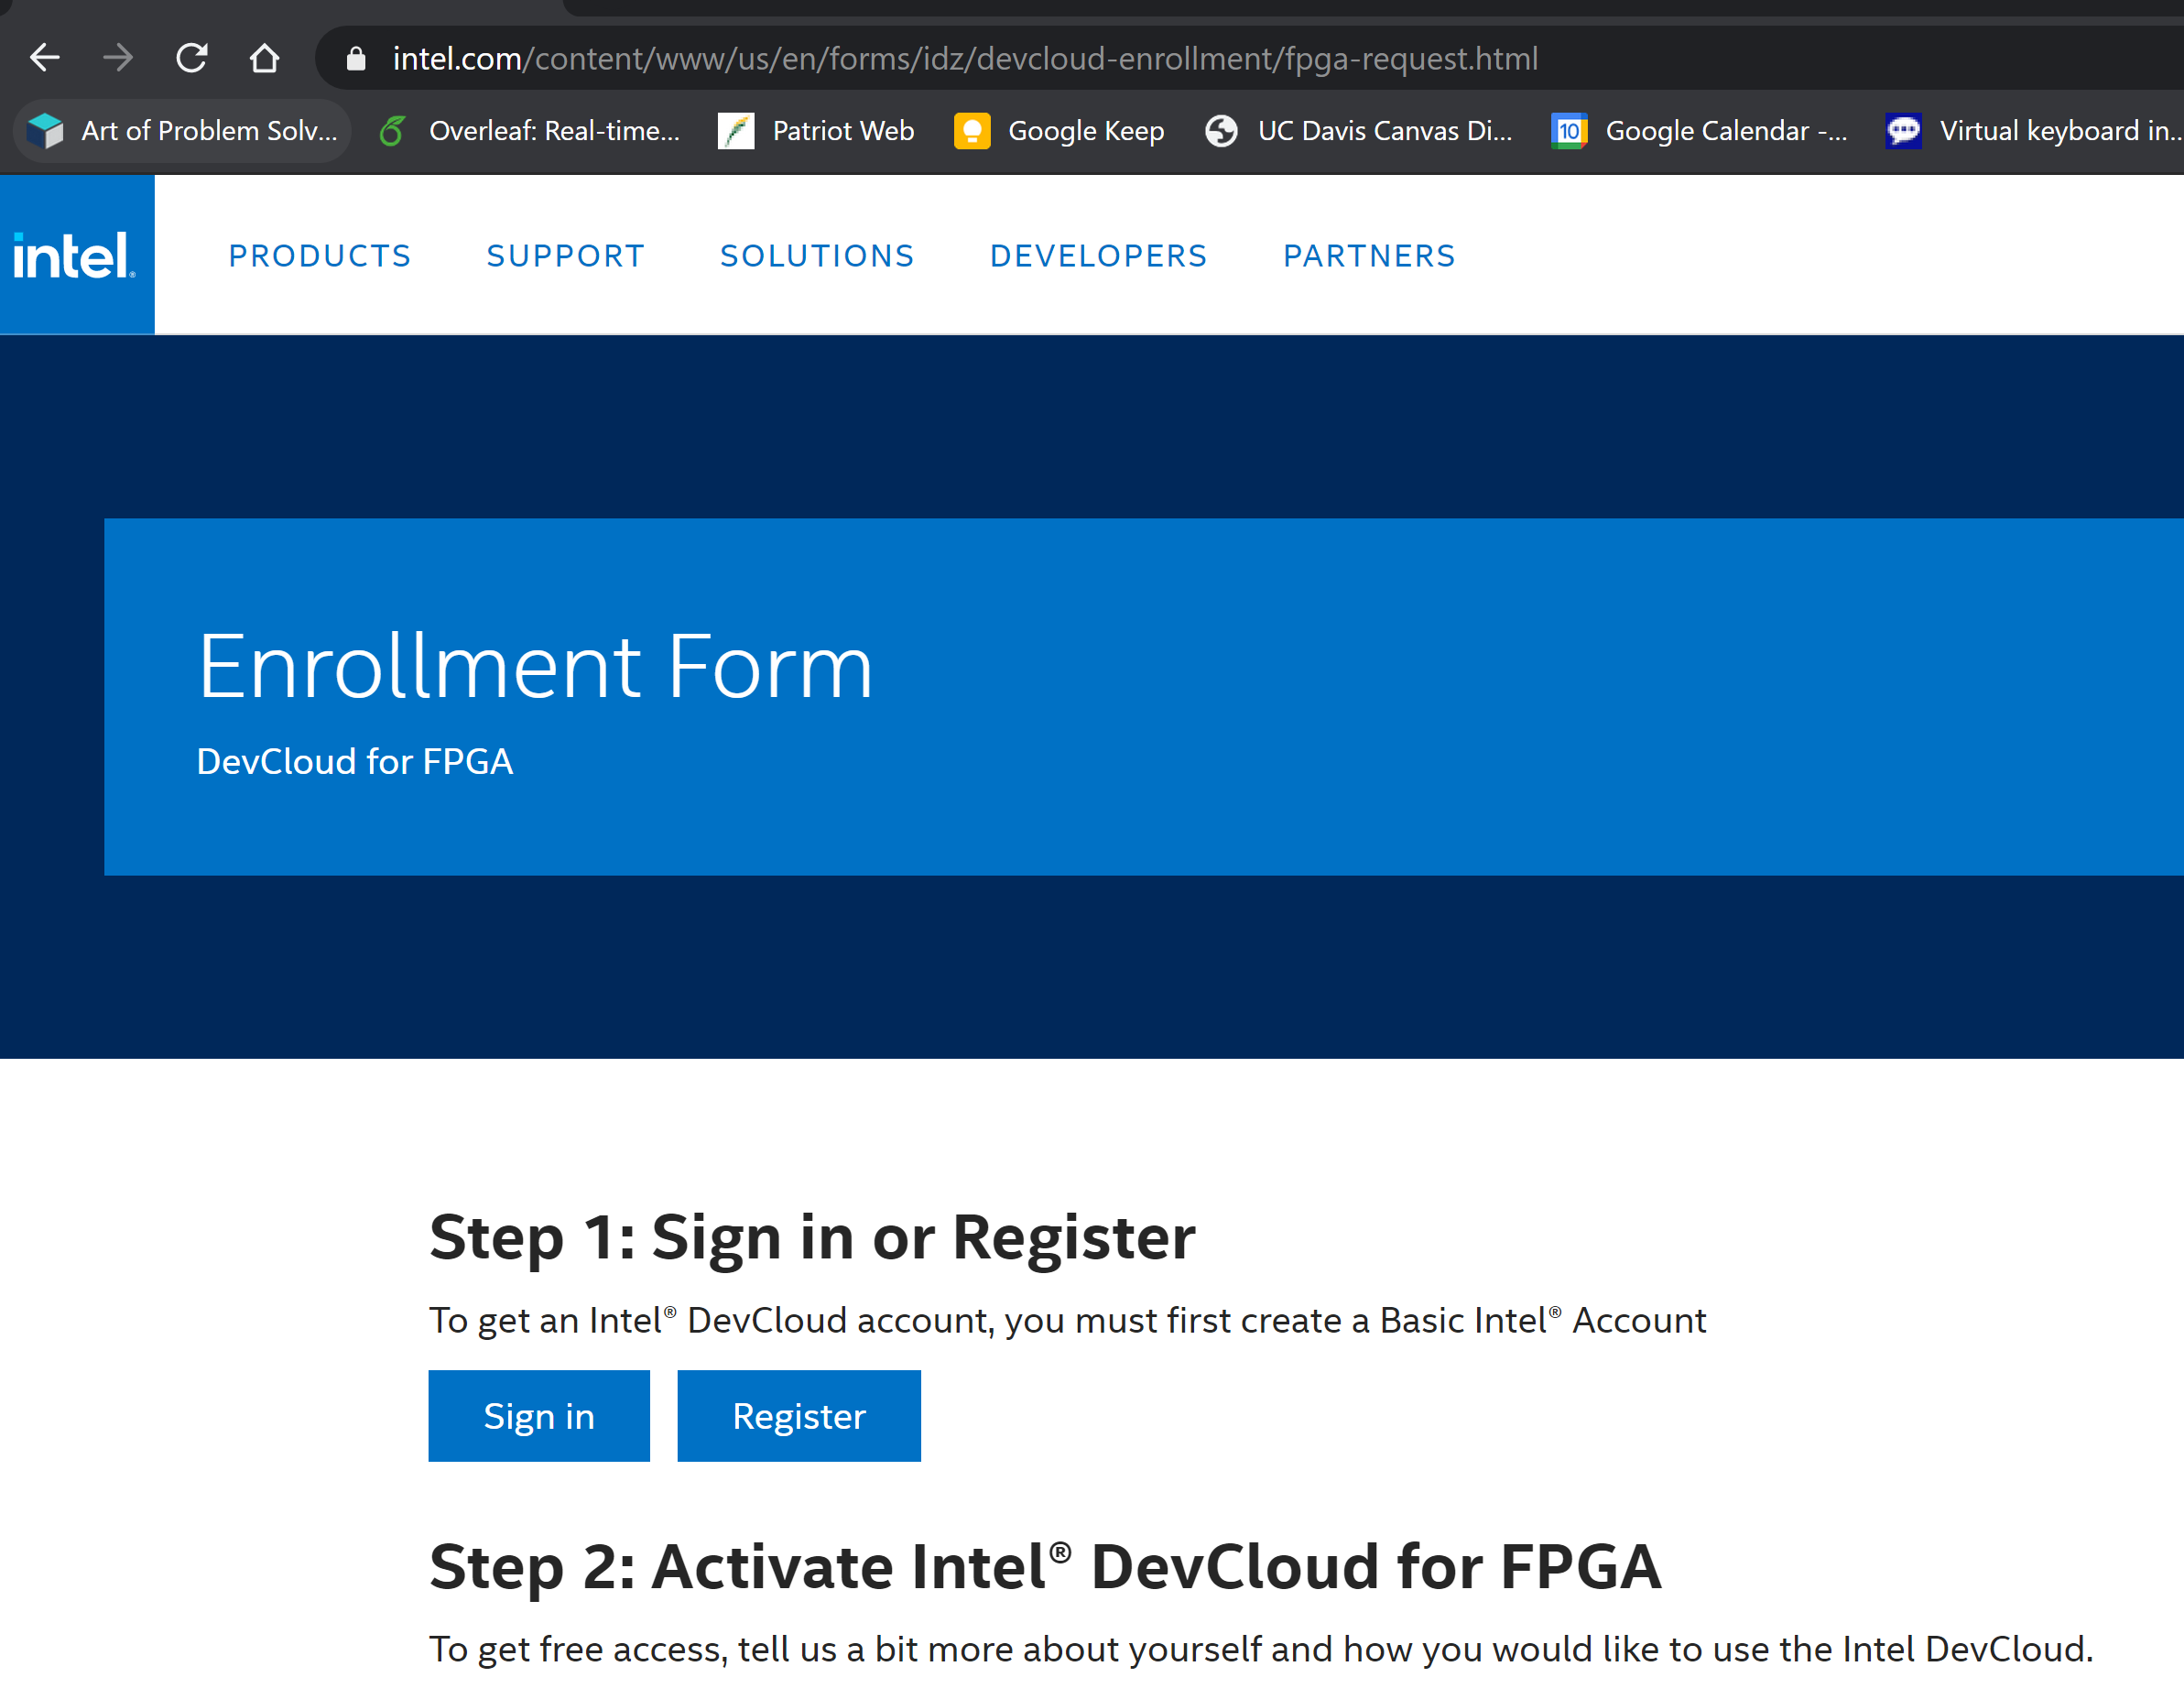
Register for FPGA DevCloud
By clicking on the Intel DevCloud home page, you will be redirected to the following page:
https://www.intel.com/content/www/us/en/forms/idz/devcloud-enrollment/fpga-request.html

Slide 39
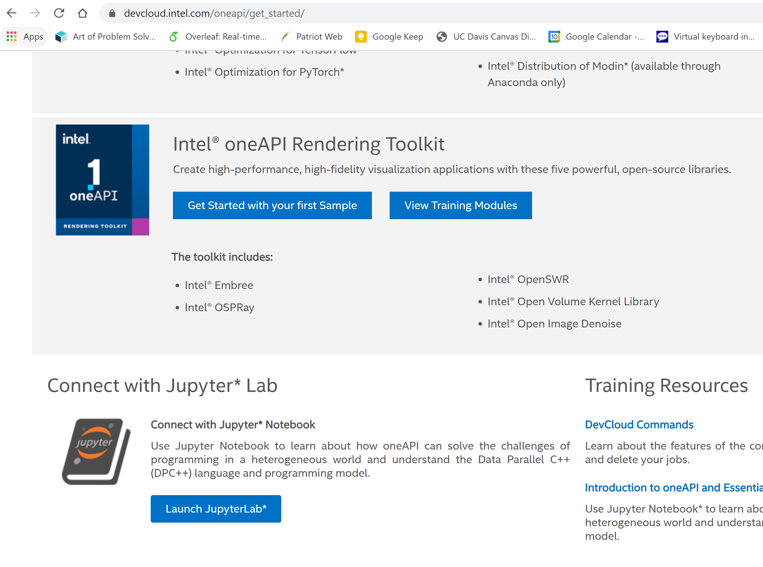
Sign in to connect with Jupyter
After sign in, by selecting launch, you access to DevCloud with Jupyter
https://devcloud.intel.com/oneapi/get_started/

Slide 40
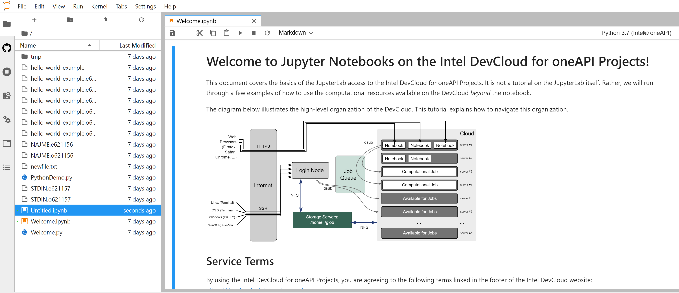
Bring up Jupiter Notebook
Click on one-click login, wait for a moment and let the Jupyter Lab environment to come up. Afterwards, you can see the interface like below:
There is Welcom.ipynb in your home folder. It is very helpful tutorial to get familiar with Jupyter Notebook in DevCLoud.

Slide 41
DPC++ Compiler on DevCloud
Command Line :
dpcpp <source_files> -<options>
options:
-o <output_name>
-fintelfpga
-c
FPGA related options:
-fsycl-link
-Xshardware
-Xsprofile
Example:
dpcpp -fintelfpga aes_dpcpp.o -Xshardware -Xsprofile

Slide 42
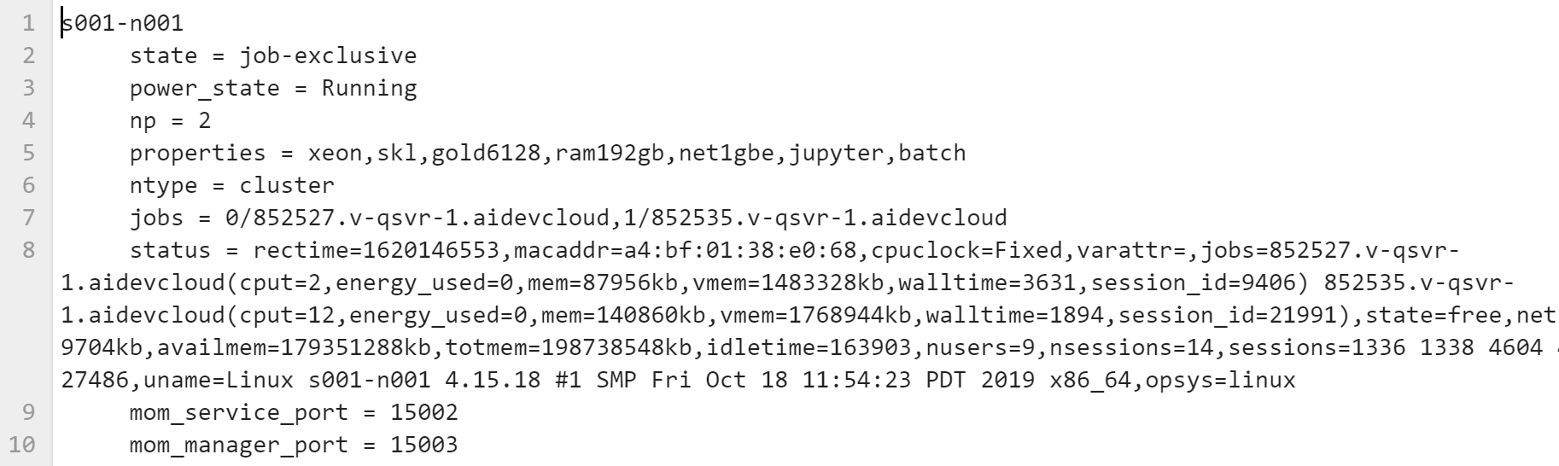
Job Submission
Submit for compile and emulation for FPGA:
qsub -l walltime=24:00:00 -l nodes=1:fpga_compile:ppn=2 -d . <jobscript_name>
Submit to run on FPGA:
qsub -l nodes=1:fpga_runtime:ppn=2 -d . <jobscript_name>
Getting the Overview of nodes on DevCloud:
$ pbsnodes > nodes.txt
Example:

Slide 43
Intel® VTune™ Profiler on DevCloud
Run Command Line Analysis:
vtune -collect <analysis_type> [-knob <knobName=knobValue>] [--] <target>
Analysis Types:
fpga-interaction
hotspots
hpc-performance
uarch-exploration
Knobs:
enable-stack-collection=true
collect-memory-bandwidth=true
Example:
vtune -collect fpga-interaction -knob collect-memory-bandwidth=true -knob enable-stack-collection=true ./myapp

Slide 44
Intel® Advisor on DevCloud
Run Command Line Analysis:
advisor-python $APM/collect.py advisor -- ./app_name
advisor-python $APM/analyze.py advisor
Results will be stored at ./advisor/e000/pp000/data.0

